Slide 1

Advanced Software Development
Flight-Gear Simulator Controller
Final Project
Course number: #600098 Lecturer: Dr. Eliahu Khalastchi Developers: Gal Jacobson & Roey Miller

Slide 2
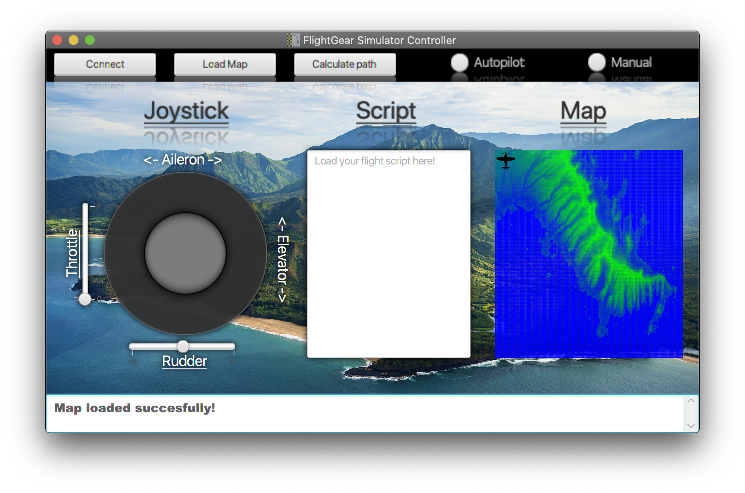
Project Milestones
1
General server side’s architecture design
Using GRASP and SOLID principles
2
Simple server solver
using smart cache-manager and file streaming
3
Implementation of BFS and A-Star algorithms
in the solver server
4
Script interpreter
using lexical analysis and syntax analysis
5
Designing and building a GUI Controller
using JavaFX
The Project App

Slide 3
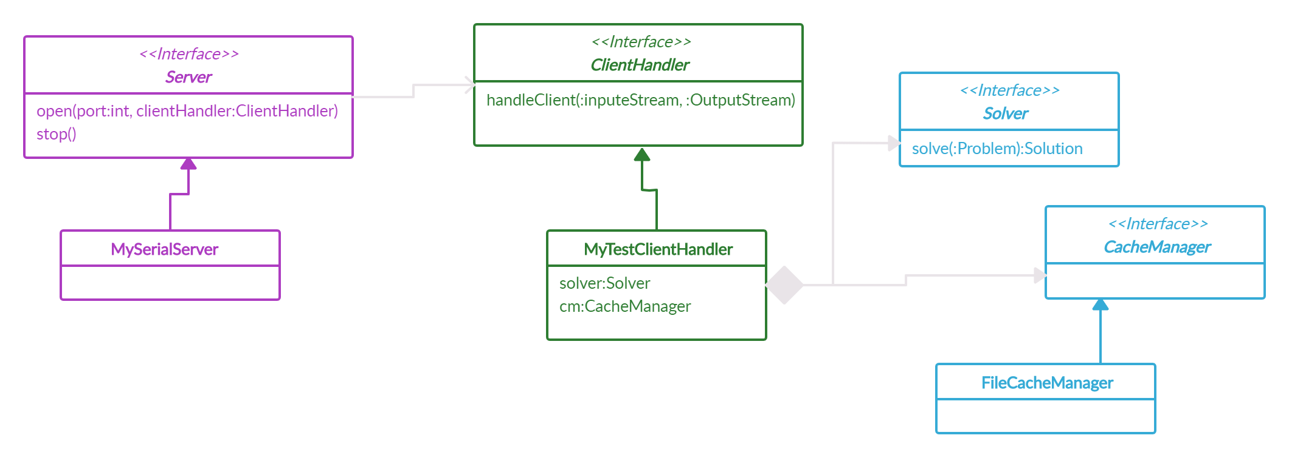
Server Side
Client-Server Architecture

Slide 4
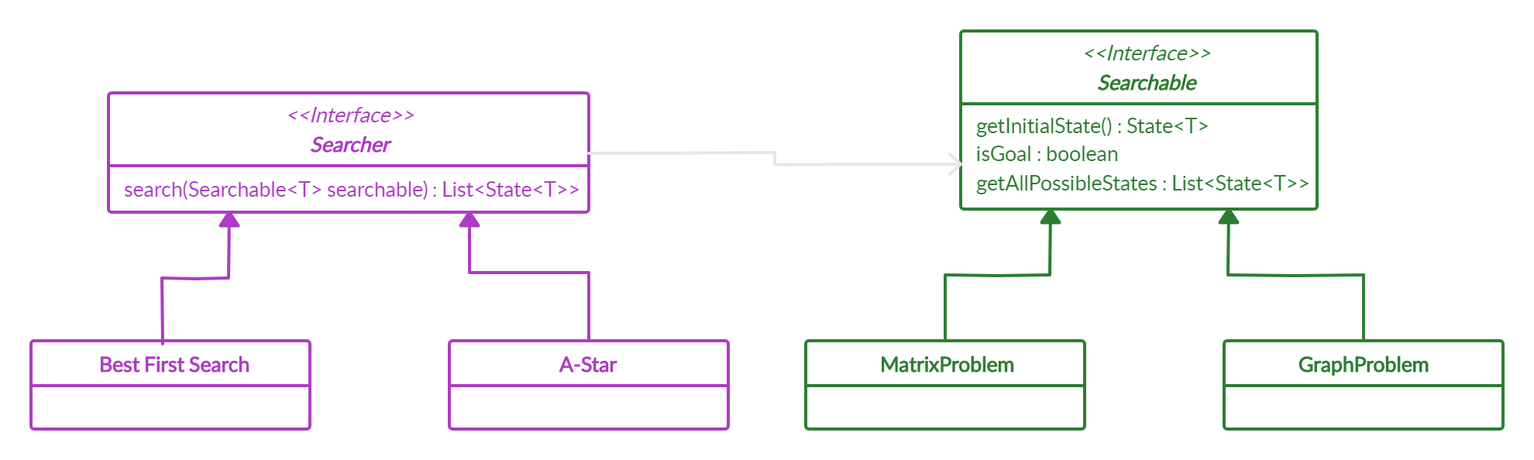
Server Side
The Problem Solver

Slide 5
Script Reader
Script
Lexer
Parser
Simulator
Custom Language
Lexical Analyzer
Functional Analyzer
Send to Simulator

Slide 6

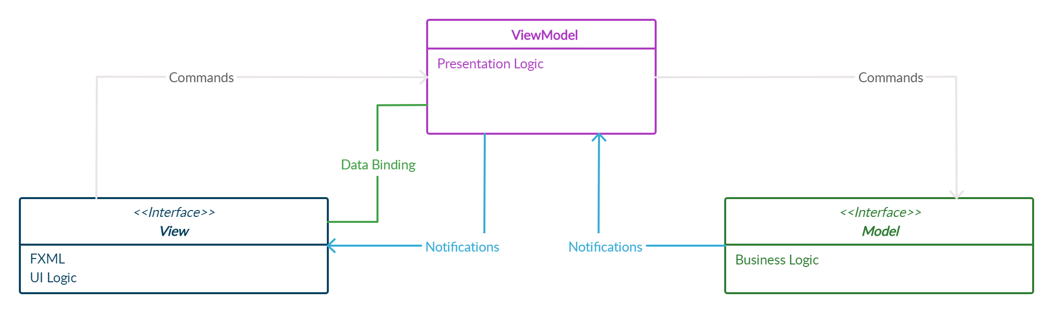
JavaFX GUI
MVVM Architecture
View
Graphical user interface (GUI)
Controllers
ViewModel
Connecting the view(GUI) to the Model(Logic Side)
Hold conmen Objects
Model
The Logic Side
The Functions

Slide 7
Joystick data binding
JoystickController
Aileron.Bind(VM.Aileron)
Elevator.Bind(VM.Elevetor)
Throttle.Bind(VM.Throttle)
Rudder.Bind(VM.Rudder)
ViewModel
setThrottle()
setRudder()
setJoystick()
SimulatorModel
SendToSimulator()

Slide 8

The Team
Gal Jacobson
Roey Miller
B.Sc. Compute Science Student 2ND year
B.Sc. Compute Science Student 2ND year
Gal Jacobson
Roey Miller
Jacobsongal@gmail.com
roeymillerp401@gmail.com
JacobsonGal
RoeyMiller

